Slide 1



Addressing Mental Health Challenges in the Tech Industry
Alec Collins Donald Doggett | Ilsa Naumani Marc Arft

Slide 2
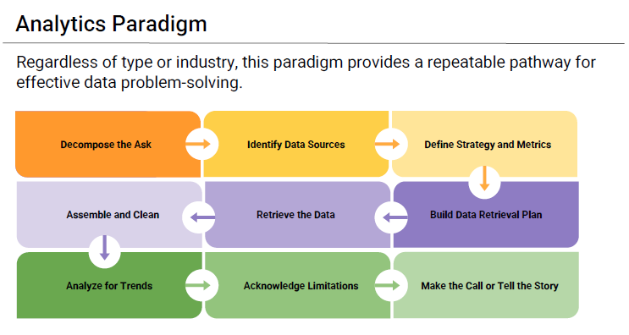

Slide 3
Research Questions we will be answering
Q1: How does constant exposure to technology affect the mental well-being of tech employees?
Q2: What is the relationship between physical activity and improved mental health outcomes in tech workers?
Q3: What is the correlation between company size and mental health issues among employees?
Q4: How does remote work impact mental health compared to on-site work?

Slide 4
Decompose the Ask?
Question 1: How does constant technology exposure affect tech employees' mental well-being, considering workplace culture, treatment accessibility, and remote work dynamics?
First: Identify the independent variables
Anonymity Care Options Coworkers Family History Mental Health Benefits Mental Health Stigma | Number of Employees Physical Health Stigma Resources Available Supervisor Tech Company Treatment Wellness Programs
Notes:
To break down the research question into measurable components, we need to identify the independent variables (factors being measured or manipulated). Independent variables are those that can influence or predict outcomes related to mental health among tech employees.

Slide 5

EXPLORATION: Identify Data Sources
Dataset: Mental Health in Tech Survey
https://www.kaggle.com/datasets/osmi/mental-health-in-tech-survey
Dataset from a 2014 survey on mental health in the tech workplace.
Focuses on attitudes towards mental health and frequency of mental health disorders.
Covers employee demographics (age, gender, occupation) and company characteristics (size, industry, location).
Examines the prevalence of mental health conditions among tech employees.
Explores workplace mental health support and resources offered by companies.
Highlights comfort levels in discussing mental health with supervisors or colleagues.
Encourages comparison with data from the ongoing 2016 survey.
Aims to identify trends in mental health awareness within the tech industry.
Notes:
This dataset comes from a 2014 survey conducted to explore attitudes towards mental health and the prevalence of mental health disorders within the tech industry. The survey aimed to better understand how employees in tech workplaces view mental health issues, whether they feel comfortable discussing mental health at work, and how mental health support is perceived in their work environments.
Key aspects of the dataset include:
Demographics: Age, gender, and occupation of respondents.
Workplace characteristics: Size of the company, industry type, and geographic location.
Mental health status: Information on whether the respondents have been diagnosed with a mental health disorder, and the prevalence of such conditions.
Workplace mental health support: Insights into whether companies offer mental health resources, and how comfortable employees are discussing mental health issues with supervisors.

Slide 6
Define Strategies and Metrics
Define Strategy/ Metrics to Collect: AgeGender Country State self_employed family_history remote_work tech_company no_employees Benefits care_options | wellness_program seek_help Anonymity Leave mental_health_consequence phys_health_consequence Coworkers Supervisor mental_vs_physical obs_consequence

Slide 7
TELLING THE STORY: Build a Data Retrieval Plan
Filter Responses by Tech Employees
Analyze the Impact of Mental Health on Work Performance
Examine the Rate of Mental Health Treatment
Evaluate the Availability of Mental Health Resources
Investigate Stigmatization and Consequences
Compare Willingness to Discuss Mental Health with Supervisors and Coworkers
Impact of Isolation on Remote Workers
Notes:
Impact of Mental Health on Work Performance: Analyze "work_interfere" responses to see if tech employees report more work interference due to mental health compared to other sectors.
Rate of Mental Health Treatment: Examine the "treatment" responses. Higher treatment-seeking rates in tech employees may indicate greater mental health issues related to technology exposure. Availability of Mental Health Resources: Assess responses to "benefits," "care_options," and "wellness_program" questions. If tech employees report fewer resources despite high stress, it suggests a gap in support.
Mental Health vs. Physical Health Perception: Evaluate "mental_vs_physical" responses. Lower scores among tech employees could indicate that mental health is not prioritized like physical health.
Stigmatization and Consequences: Review "mental_health_consequence" and "obs_consequence" responses. A belief among tech employees that discussing mental health may lead to negative outcomes could point to a toxic work environment.
Willingness to Discuss Mental Health: Analyze "coworkers" and "supervisor" responses. Lower willingness among tech employees to discuss mental health may reflect a culture of isolation exacerbated by remote work and high demands.
Impact of Remote Work: Investigate "remote_work" responses. Correlate remote work with mental health challenges like treatment-seeking and willingness to discuss issues, highlighting potential effects of isolation and constant tech engagement.

Slide 8

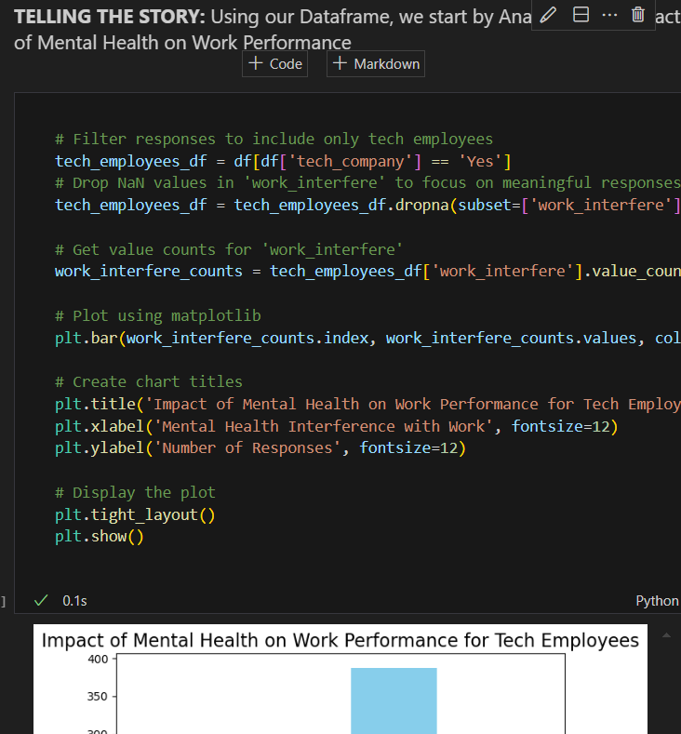
See Notebook

Slide 9
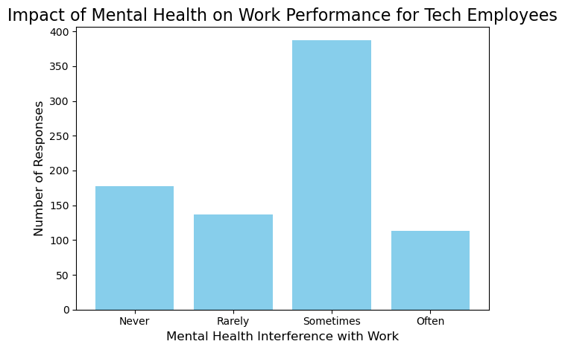
Analyze the Impact of Mental Health on Work Performance
This graph tells us that "Sometimes" is the most common frequency of mental health interference, with approximately 350-400 employees reporting this
This suggests that mental health occasionally impacts work performance for a significant portion of tech employees.

Slide 10
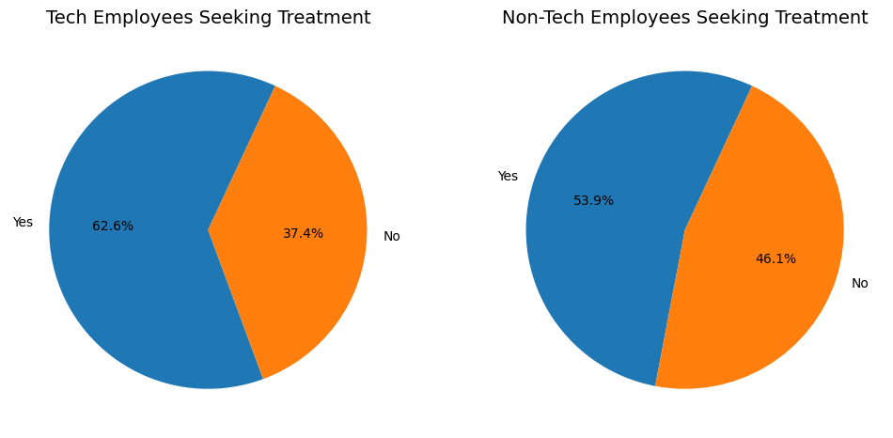
Examine the Rate of Mental Health Treatment
This chart shows that 62.6% of tech employees have sought treatment for mental health issues vs. 53.9 in non-technical roles.
The data suggests that a significant portion of tech employees are aware of the mental health challenges they face, possibly exacerbated by constant technology exposure, and more seek treatment to address these issues than do non-tech employees.

Slide 11
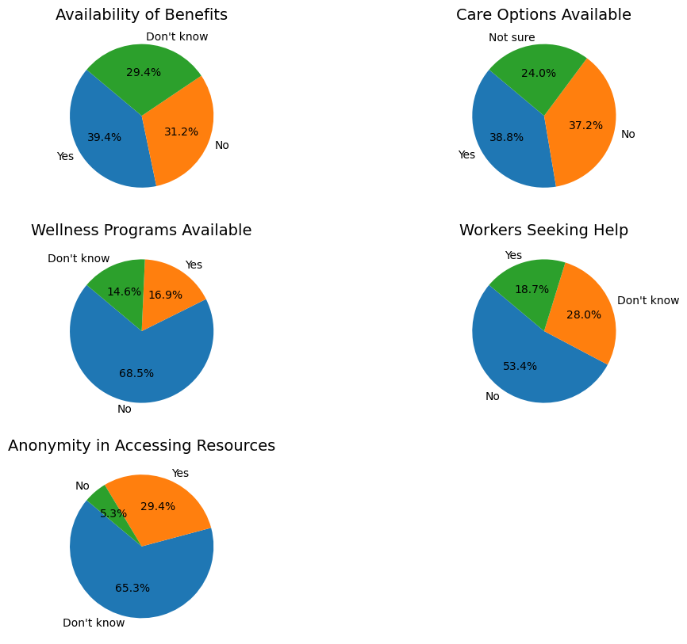
Evaluate the Availability of Mental Health Resources
If mental health resources are widely available and effectively utilized, tech employees may be better equipped to handle stress, anxiety, or burnout. This support can directly reduce the negative impact of mental health issues on their productivity, focus, and overall job performance.
According to these statistics, many workers do not have or do not know about mental health resources.

Slide 12
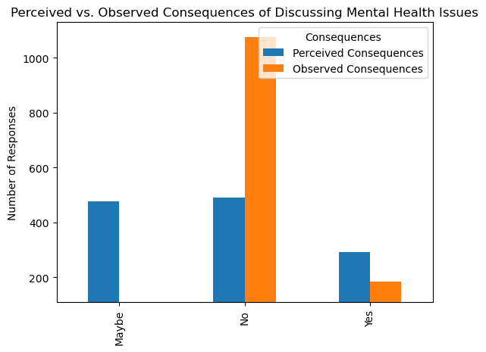
Investigate Stigmatization and Consequences
Analyzing concerns about discussing mental health issues in the workplace highlights the impact of constant technology exposure on tech employees' mental well-being. The data shows that perceived consequences of discussing mental health are significantly higher than actual observed consequences, indicating a disconnect between employee fears and the realities faced by their coworkers. This gap underscores existing stigma and support structures within workplace culture and suggests that technology may exacerbate feelings of isolation and pressure. Furthermore, observed consequences for coworkers with mental health conditions reveal potential negative patterns in workplace dynamics, especially in remote work settings.

Slide 13
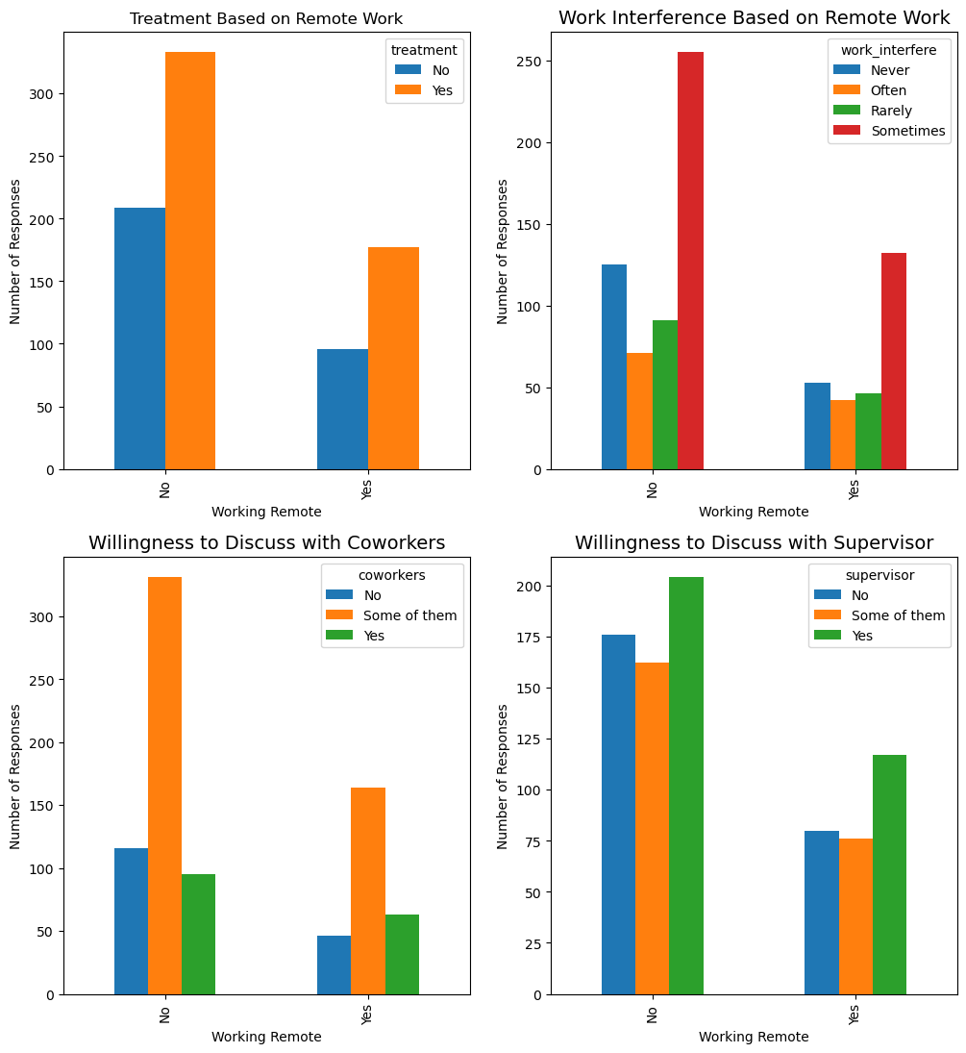
Compare Willingness to Discuss Mental Health with Supervisors and Coworkers
Evaluating the concerns related to discussing mental health issues in the workplace provides crucial insights into the impact of constant technology exposure on tech employees' mental well-being. By examining the perceived consequences of discussing mental health, one can identify existing stigma and support within the workplace culture, highlighting how technology may exacerbate feelings of isolation and pressure. Observed consequences for coworkers with mental health conditions reveal potential negative outcomes and patterns that reflect workplace dynamics, especially in remote work settings.

Slide 14
Analysis
Question 1: How does constant technology exposure affect tech employees' mental well-being, considering workplace culture, treatment accessibility, and remote work dynamics?
The analysis reveals that mental health issues intermittently affect a significant portion of tech employees, with many seeking treatment at higher rates (62.6%) compared to non-tech workers. However, despite this awareness, challenges remain due to limited access to mental health resources and a prevalent stigma surrounding mental health discussions in the workplace. Tech employees often fear potential consequences of disclosing mental health struggles, even though the actual risks are lower than perceived, especially in remote work environments where isolation and pressure are more pronounced. To improve mental well-being and work performance, organizations must enhance resource availability, reduce stigma, and foster a supportive, open culture around mental health conversations.

Slide 15

Q2. What is the relationship between physical activity and improved mental health outcomes in tech workers?

Slide 16
EXPLORATION: Identify Data Sources
Sleep Health and Lifestyle Dataset on Kaggle
https://www.kaggle.com/datasets/uom190346a/sleep-health-and-lifestyle-dataset
I found the 'Sleep Health and Lifestyle Dataset' on Kaggle to be incredibly insightful. It contains valuable information on various factors such as sleep patterns, lifestyle choices, and demographics. These metrics provide a comprehensive view that is helpful for analyzing sleep health trends and their correlations with lifestyle habits

Slide 17
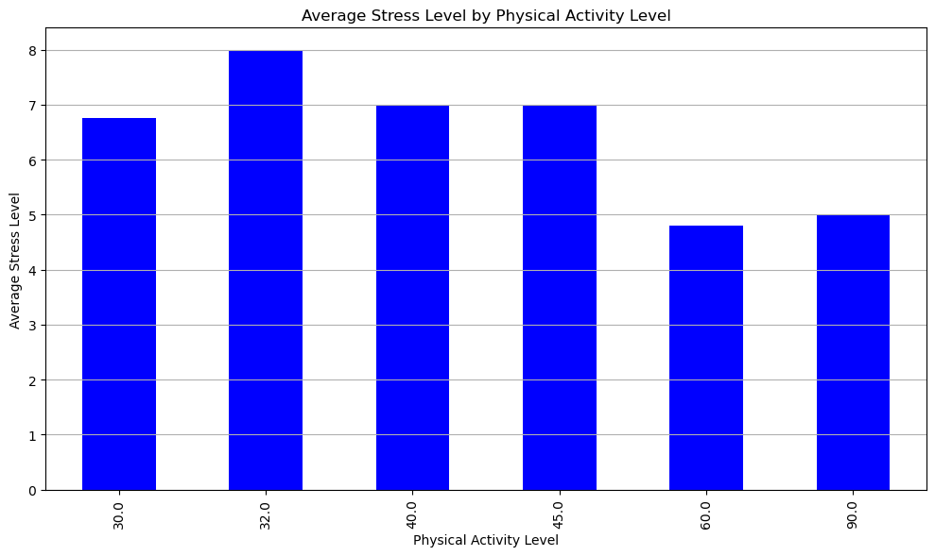
Physical Activity Level vs. Stress Level :
We observed a negative correlation between physical activity levels and stress levels. With the new filtered data, we expect this trend to persist.
For the remaining occupations like Software Engineers and Engineers, their stress levels may show clearer declines with higher physical activity, given that these professions are often sedentary, and physical activity can provide a significant mental health benefit.
Analysis: The relationship between physical activity and stress reduction should remain visible or even more pronounced in the filtered group, confirming that engaging in regular physical activity helps mitigate stress, especially in professions with a sedentary nature like engineering and sales.

Slide 18
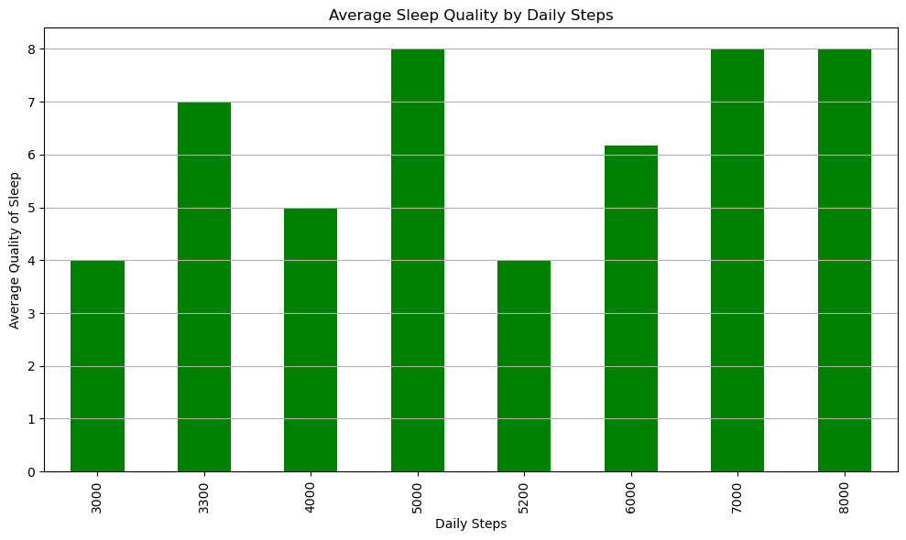
Daily Steps vs. Sleep Quality
More daily steps were correlated with better sleep quality. After filtering out some occupations, this correlation should still be relevant but might show more consistency across the remaining tech-related professions.
Tech workers like Software Engineers and Engineers, who generally work long hours in front of screens, can benefit from physical activity, particularly in terms of improved sleep. Increased daily steps are likely to contribute to better sleep quality in these roles due to the positive effects of exercise on reducing stress, improving cardiovascular health, and promoting better sleep cycles.
Analysis: With the filtered data, the relationship between daily steps and sleep quality is expected to become clearer. Occupations like software engineering, which are highly sedentary, are more likely to exhibit improvements in sleep quality as their physical activity increases. This reinforces the notion that even light physical activities like walking can significantly improve sleep and, consequently, mental health in tech professions.

Slide 19
Analysis:
Stress Reduction through Activity: Tech workers and those in sedentary roles can benefit greatly from increasing their physical activity levels. The filtered dataset helps focus on these roles, where physical activity may not only improve physical health but also significantly reduce stress. Better Sleep through Steps: As most of the remaining occupations (software engineers, engineers) involve long hours of sitting, the data shows that adding physical activity (e.g., through walking) has a positive impact on sleep quality. Better sleep leads to improved overall mental health, reduced anxiety, and greater work productivity. In summary, the filtered dataset supports the same trends but allows for clearer analysis by focusing on tech-related occupations. Increased physical activity continues to demonstrate a strong correlation with lower stress and improved sleep, especially in roles that are predominantly sedentary.

Slide 20
Q3: What is the correlation between company size and mental health issues among employees?

Slide 21
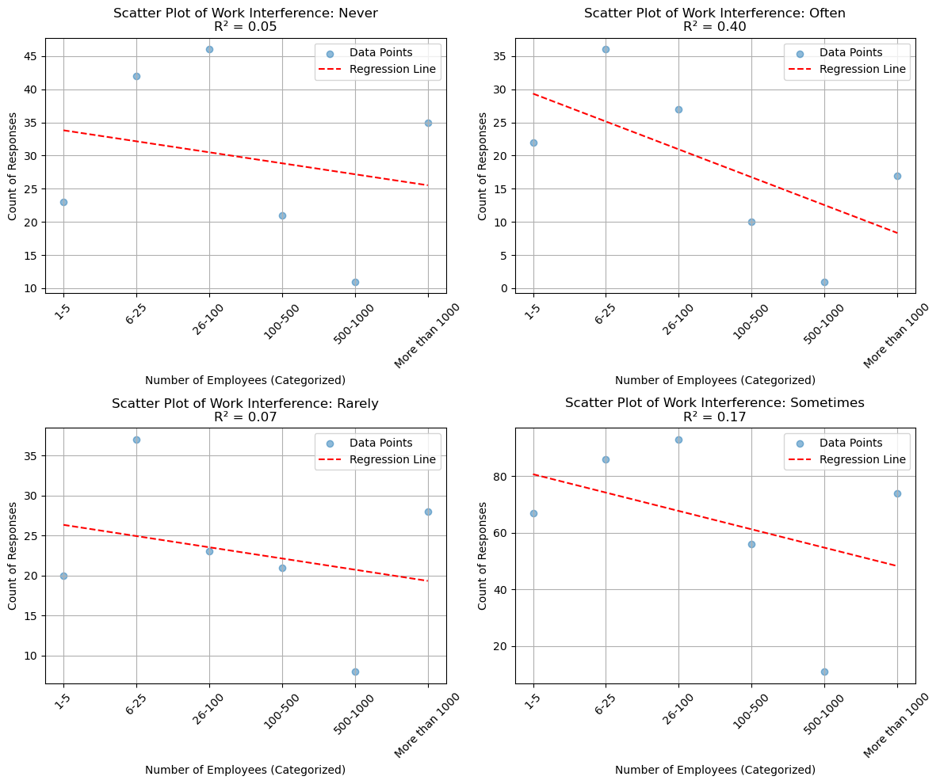
How company size might interfere with mental Health
According to my scatter plots, linear regression, and R squared value there isn't a correlation between size of the company and work interfering with mental health.

Slide 22
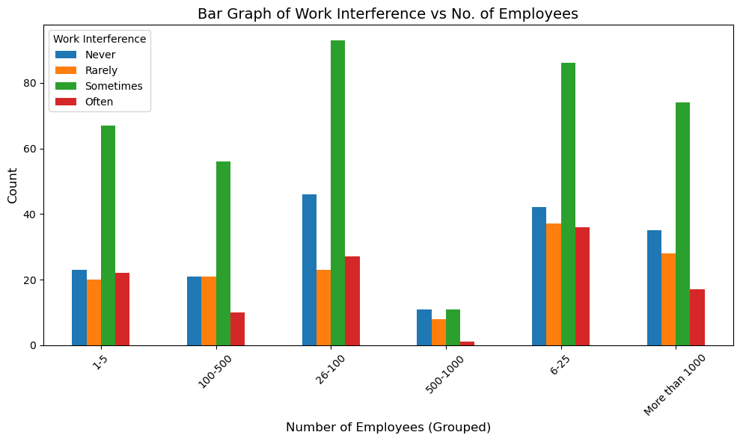
Company size vs work interference
As you can see it doesn’t matter what size your company is. Work will always sometimes interfere with your mental health.

Slide 23
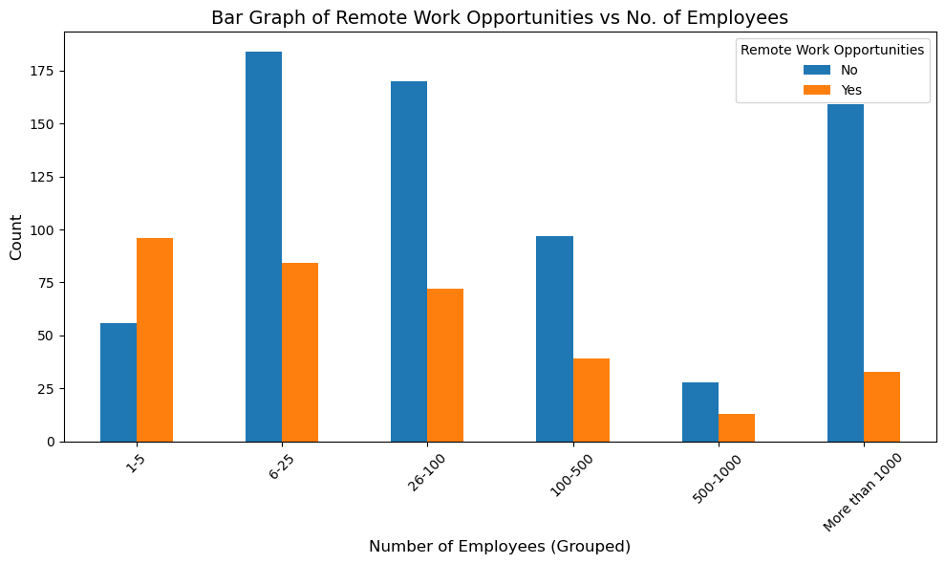
Company size vs remote work opportunities
The larger the company the less work from home opportunities are available.

Slide 24
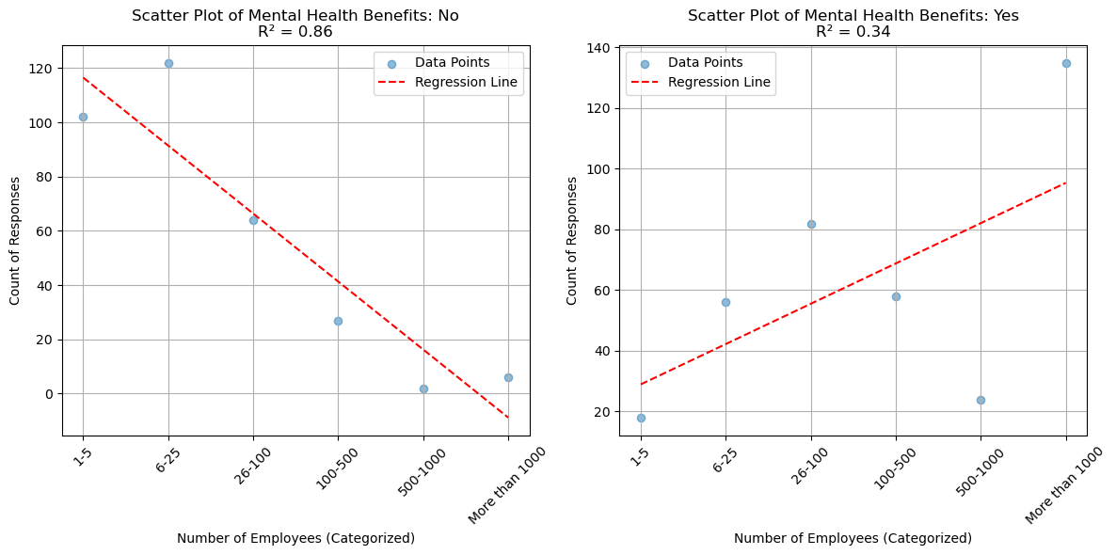
Company Size vs Mental Health benefits
As company size gets larger the number of companies providing mental health benefits increases.

Slide 25
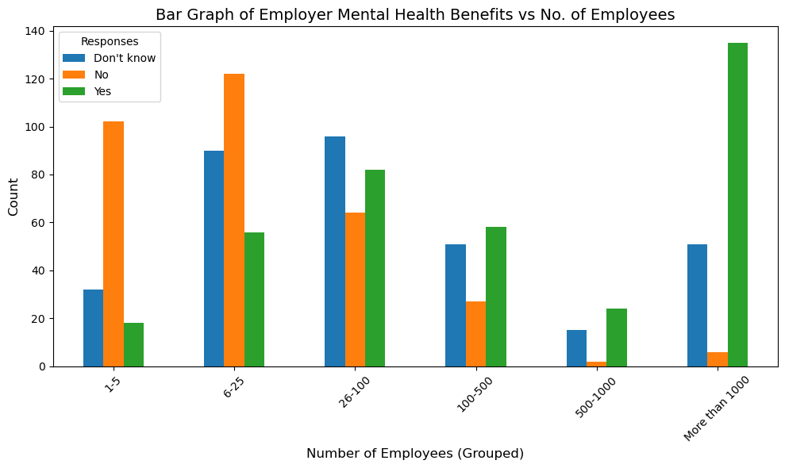
Company size vs mental health benefits
As the company size increases the likelihood of employer provided mental health benefits increases. And drastically increases once there are 1000 or more employees.

Slide 26
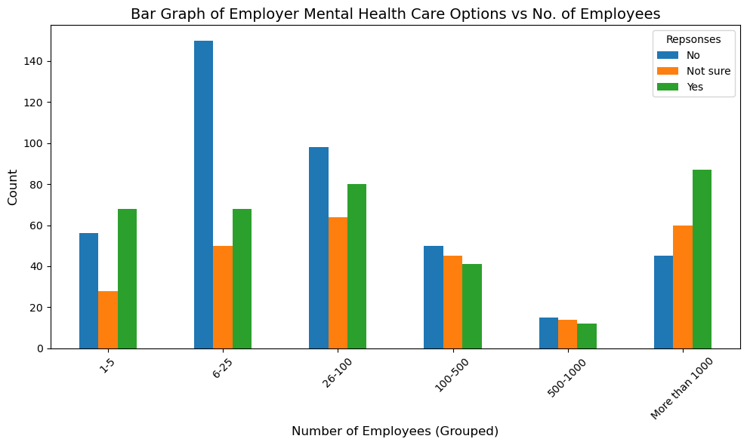
Company Size vs Mental Health care options
As the company size increases more resources are put towards their mental health care options being known.

Slide 27
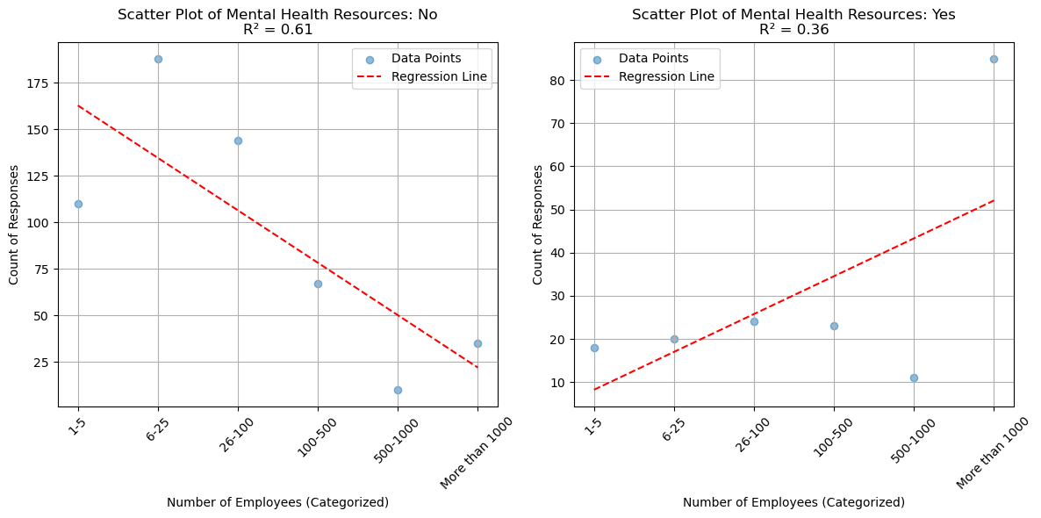
Company size vs Mental health resources
Also, as the company size increases the number of companies with resources to learn about mental health and how to seek help.

Slide 28
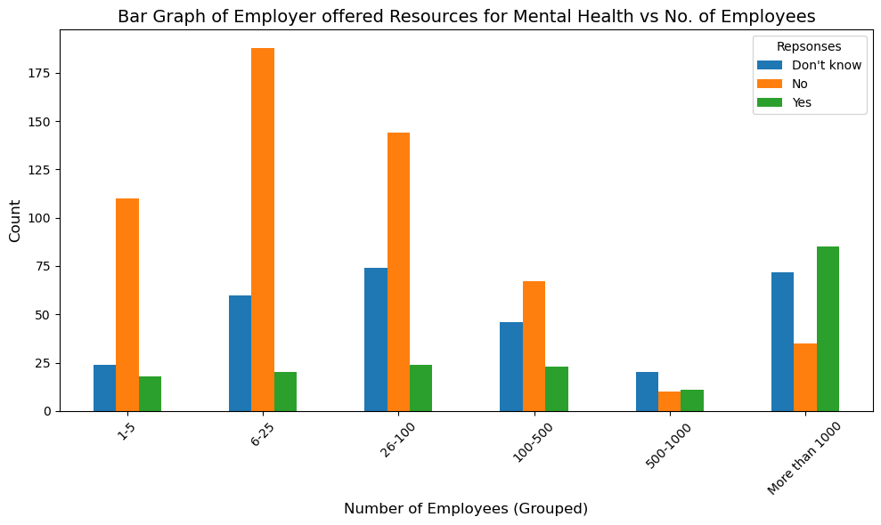
Company size vs Mental health resources
Unfortunately, it seems a lot of people don’t know about these provided resources. Still the number of companies with these resources goes up as the company size increases.

Slide 29
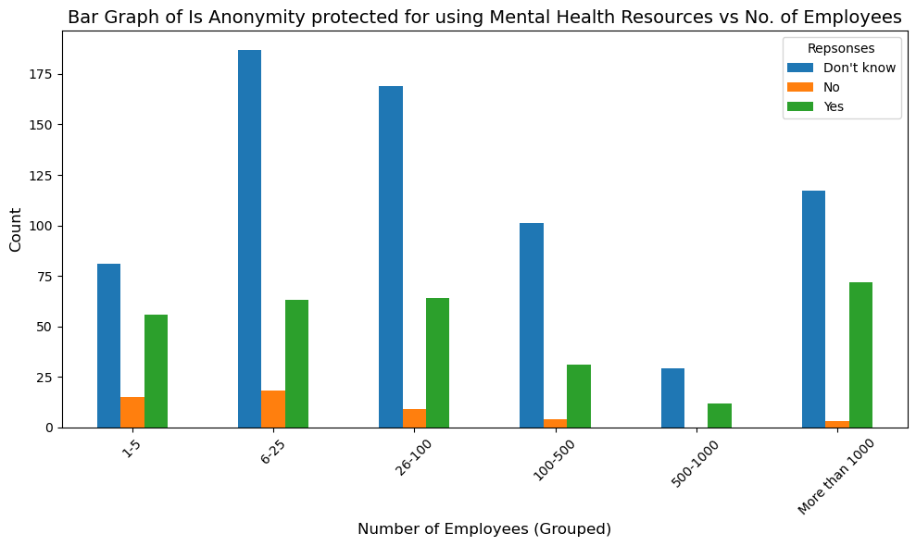
Company size vs Anonymity
Across all company sizes anonymity is protected for using mental health resources. A little less protected in smaller companies but overall companies are protecting it across the board.

Slide 30
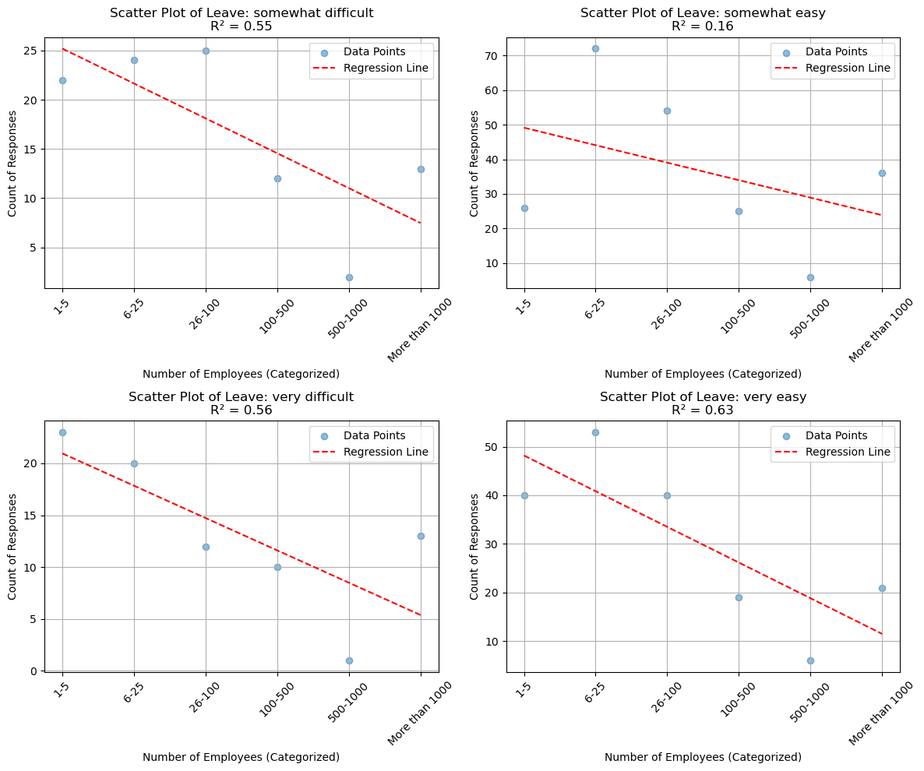
Company size vs Ease of mental health leave
As company size increases the ease of taking a mental health leave doesn’t increase. It seems that in every company its somewhat easy to take a mental health leave.

Slide 31
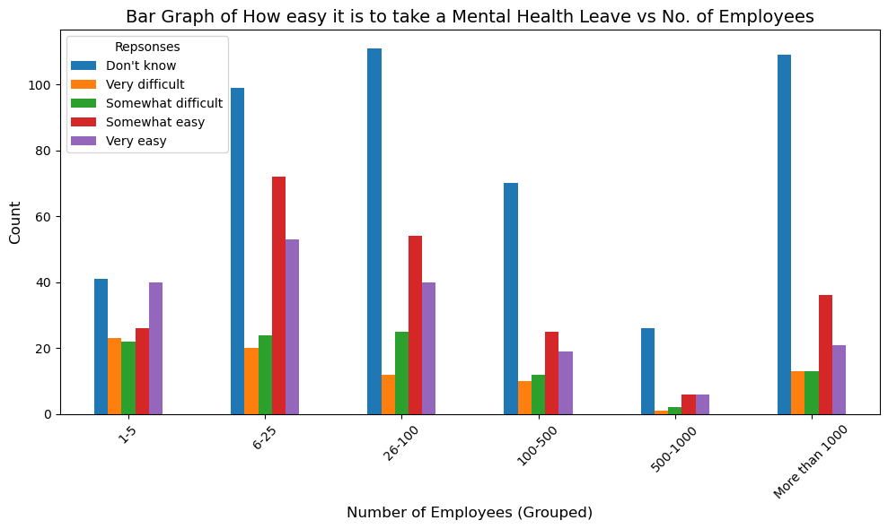
Company size vs Mental health leave
Although a lot of people in the companies seem to find it somewhat easy there are a lot of people in the companies that ‘Don’t know’ which could affect mental health if employees don't feel comfortable taking leave for their own mental health.

Slide 32
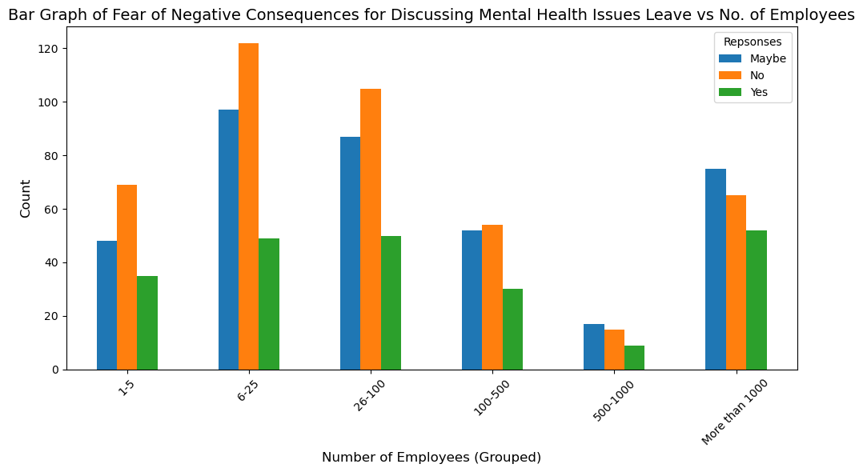
Company size vs Fear of negative consequences
As company size increases the fear of negative consequences also increases. While most people still think there won't be consequences the number of people that do still rises as the company size increases.

Slide 33
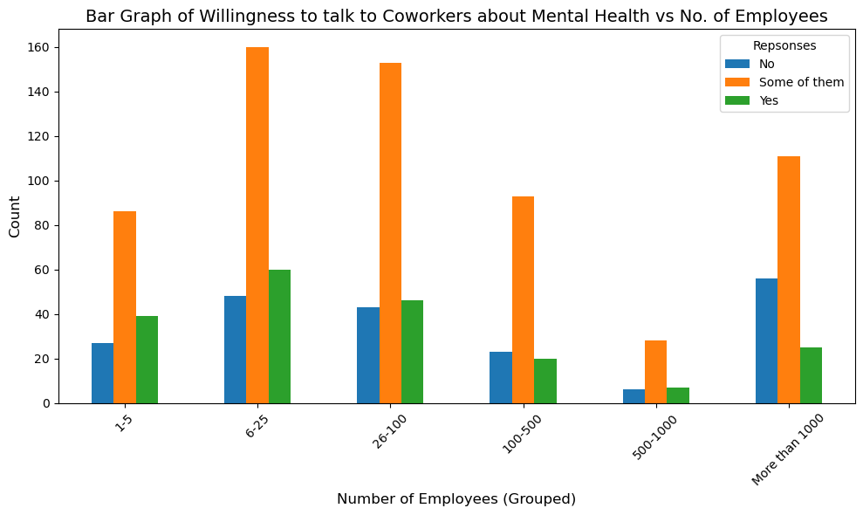
Company size vs talking to coworkers
Across all company sizes, everyone is willing to talk to some of their coworkers. And it seems as the company size increases more people answer ‘No’, which makes sense as most people do not want to share their mental health with everyone.

Slide 34
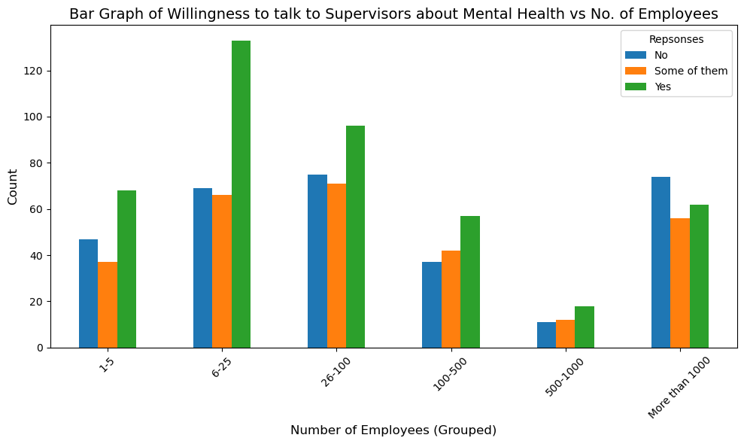
Company size vs talking to supervisors
Across all company sizes people are willing to talk to their supervisors about their mental health. But as the company size increases there is a substantial increase in the amount of people not willing to talk to them as well.

Slide 35
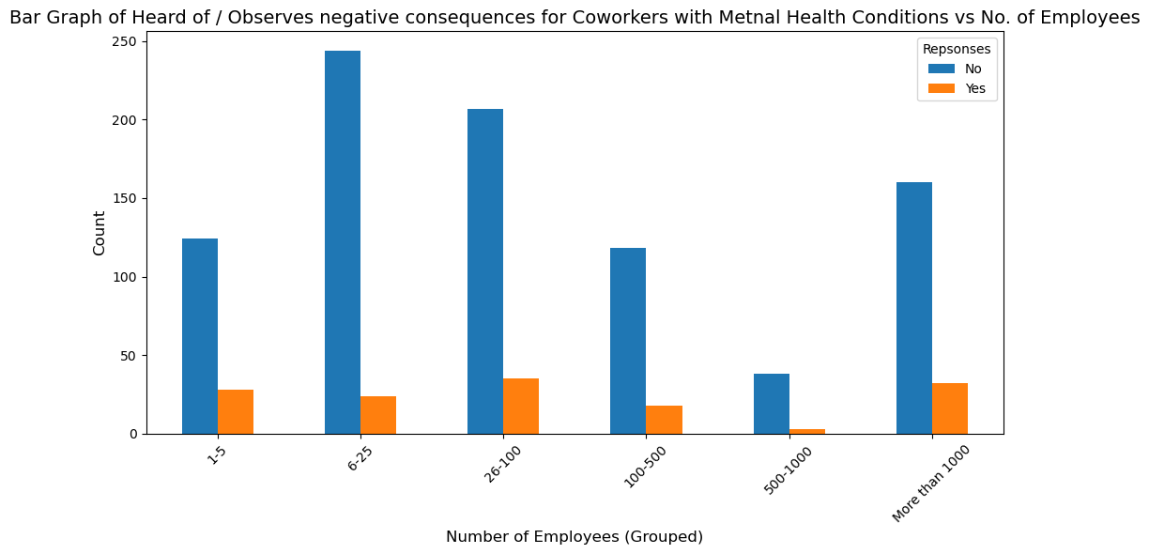
Company size vs observed consequences
In every company size the vast majority of people have not observed or heard of negative consequences for their mental health condition.

Slide 36
Analysis
“Q3: What is the correlation between company size and mental health issues among employees?”
From the Mental Health in Tech survey, it seems that no matter what your company size, work will sometimes affect your mental health. However, larger tech companies tend to offer many resources promoting mental health, including comprehensive employee assistance programs, wellness initiatives, and access to mental health professionals. These resources can create a more supportive environment for employees facing mental health challenges. In contrast, smaller companies might lack the same level of resources but can create closer communities and personal connections that also contribute to mental well-being. Ultimately, while larger companies may provide more structured support options, the individual experience of mental health in the workplace can vary greatly, regardless of company size.

Slide 37
Q4: How does remote work impact mental health compare to on-site work?
Focusing on the ‘it’ industry

Slide 38
EXPLORATION: Identify Data Sources
Remote Work & Mental Health Waqi786. (2023). Remote Work and Mental Health [Data set]. Kaggle. https://www.kaggle.com/datasets/waqi786/remote-work-and-mental-health
I found “Remote Work & Mental Health” on Kaggle to be a very interesting dataset. This dataset has information on gender, industry, mental stress levels and many other insightful details which were a great metric when analyzing on the whole.

Slide 39
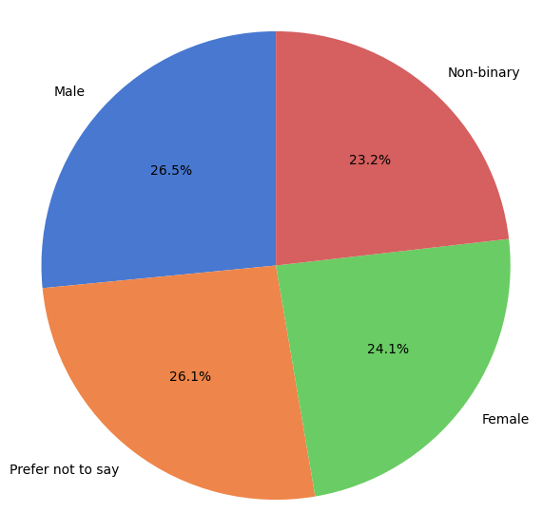
Gender % in the IT industry
This figure illustrates the gender distribution within the IT industry. While the proportions of males and females appear relatively balanced, it's important to note that 26% of individuals opted not to disclose their gender. This non-disclosure rate should be considered when interpreting the data, as it may affect the perceived distribution.

Slide 40
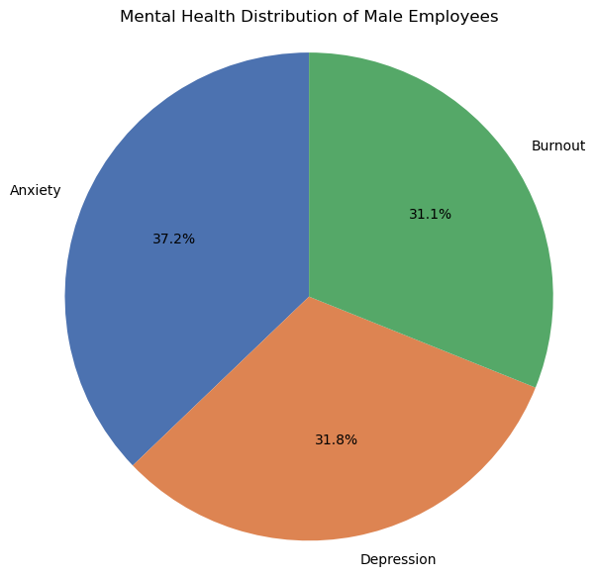
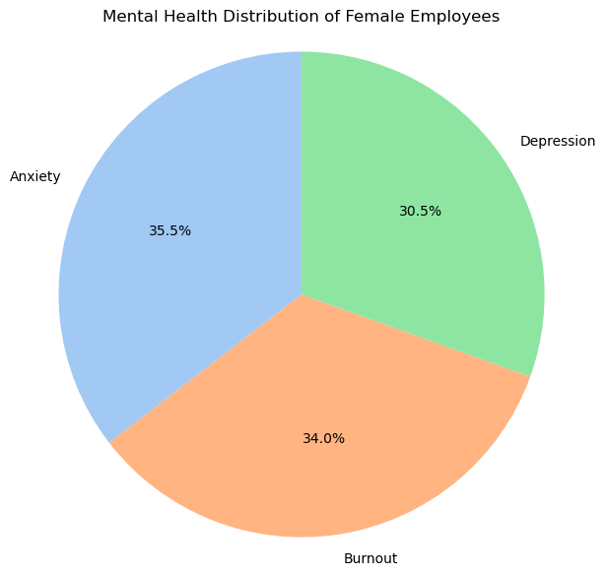
Male vs female mental health
The overall takeaway regarding mental health in the IT industry is that both males and females experience comparable levels of anxiety, depression, and burnout. This suggests that, despite potential differences in job roles or workplace environments, mental health challenges appear to affect individuals similarly across genders in this sector.

Slide 41
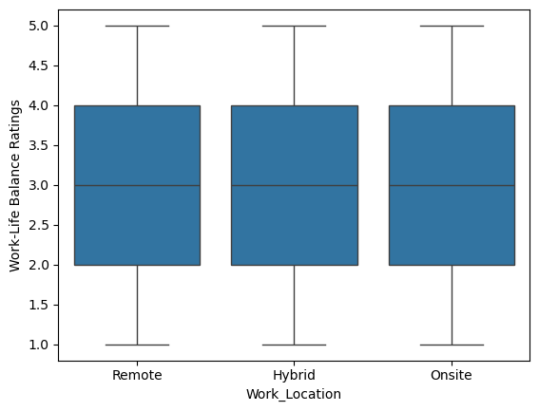
Work-life balance rating
It is notable that the ratings across all three work environments—remote, hybrid, and on-site—are quite similar. This result contrasts with the initial expectation that remote work would significantly enhance employees' perception of work-life balance. The anticipated distinction in favor of remote work did not materialize, suggesting that factors beyond work location may play a more substantial role in influencing employees' sense of balance and well-being.

Slide 42
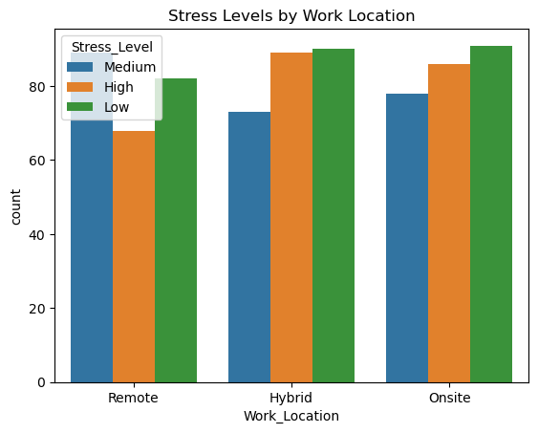
Stress levels by work locations
The graph provides a clear depiction of both hybrid and on-site roles, which exhibit the highest number of responses at low stress levels. However, these roles also show a significant number of responses at high stress levels.
A key takeaway from this graph is that the number of remote workers is comparatively lower than in the other two work environments, which may explain the reduced representation in this dataset.

Slide 43
Analysis
“How does remote work impact mental health compare to on-site work?”
After thoroughly analyzing the dataset related to mental health and work location, it appears that the impact of remote work on mental health is not as significant as initially anticipated. The data shows minimal variance in stress levels between remote and on-site workers. While factors such as the smaller proportion of remote workers compared to on-site or hybrid workers must be taken into account, the overall difference remains unexpectedly minor, contrary to my original hypothesis.

Slide 44
Thank you!

